Slide 1
Operational amplifier: Inverting and Non-inverting Amplifier

Slide 2
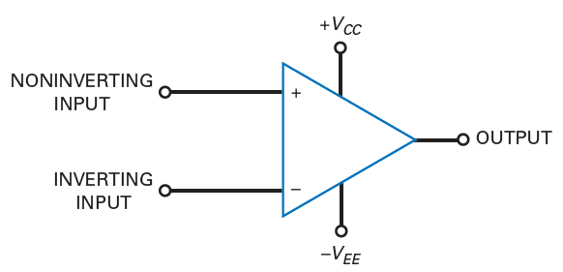
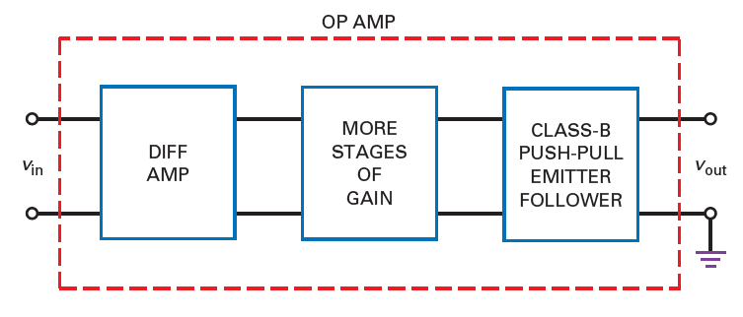
Introduction to Op-Amps
The ideal op amp represents a perfect voltage amplifier and is often referred to as a voltage-controlled voltage source (VCVS)
LM741 is common
Lecture 34

Slide 3
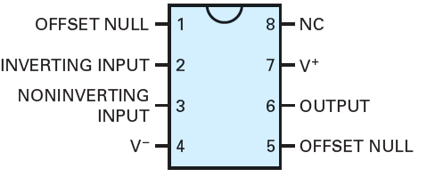
Characteristics of an ideal op-amp
Infinite input resistance, Ri = infinity
Zero output resistance, Ro = 0
Infinite voltage gain, AV = infinity
Infinite bandwidth, BW = infinity
Infinité Common-mode rejection ratio
Infinite slew-rate
Zero offset, i.e. when V1 = V2, Vo = 0
Characteristics do not drift with temperature.
Vo = A(V1 – V2)
Lecture 34

Slide 4


Op-amp parameters
Input offset voltage
The voltage that is to be applied to the two input terminals of the op-amp to null the output
Input offset current
The difference between the two input currents
Input bias current
Average of the two input currents
Common mode rejection ratio
It is the ratio between the differential voltage gain to common voltage gain
Slew rate
It is defined as the maximum rate of change in output voltage per unit of time and is expressed in volts per microseconds, that is how fast the op-amp can respond
Lecture 34

Slide 5
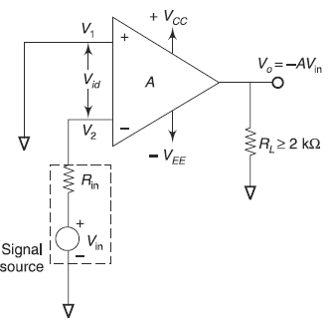

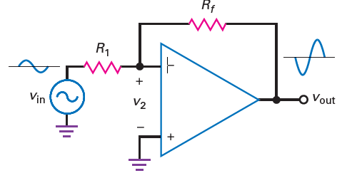



Inverting amplifier
Inverting amplifier example
Lecture 34

Slide 6
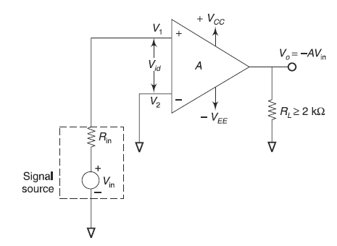

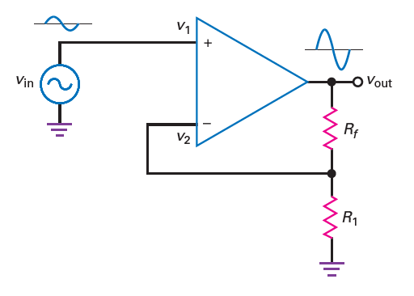



Non inverting amplifier
Non inverting amplifier example
Lecture 34

Slide 7
Thank You

